Slide 1
kongressihanke
KOKEMO –Kongressit ja yritystapahtumat innovaatioiden ja kestävyyden moottoreina pääkaupunkiseudulla -hanke
Tavoitteena lisätä alan kilpailuetua tekemällä pääkaupunkiseudusta maailman kestävin kokous- ja kongressikohde
Rahoitus: EU / Uudenmaan liitto, Enter Espoo, Helsingin kaupunki, Vantaan kaupunki
1.3.2024 – 28.2.2026

Slide 2
Pääkaupunkiseudun Kestävän kokous- ja kongressialan yhteinen Tarina ja pääviestit
Esimerkkikuva, kuva ei lopulliseen käyttöön

Slide 3
Where the happiest events happen
Bring your congress or event to the Helsinki region, a capital of happiness and intellect, ranked the world's most sustainable destination. Here, Nordic charm meets a modern city vibe, and our certified venues ensure that you don’t have to worry about a thing. The changing seasons, dazzling Finnish nature, and a sense of freedom provide memorable adventures between meetings. Enjoy human-scale spaces, easy-to-use public transportation, and friendly, hospitable locals. Better yet, come discover it all for yourself!
Esimerkkikuva, kuva ei lopulliseen käyttöön

Slide 4
Unique selling points
Nordic charm, global feel
The Helsinki region blends the distinctive Nordic quality of life with a cosmopolitan mindset. It offers an unconventional yet perfect mix of modern city life and serene natural experiences, making it an ideal destination for large-scale congresses and intimate gatherings alike. Here everybody is free to move around and truly be themselves.
The world’s most sustainable travel destination
Host your next event in the world’s most sustainable destination, ranked #1 on the Global Destination Sustainability Index. Our venues and hotels are certified, and you'll also experience genuine hospitality and Finland’s widely acclaimed work-life balance.
Where wild ideas meet intellectual capital
Visitors will discover an unexpected capital of intellect, where a dynamic atmosphere of knowledge, wellness, forward-looking tech, and unexpected creativity converge. This is brought to life by some of Europe’s most fascinating universities, companies, and communities.
Human-scale, effortlessly functional
With an airport awarded for best client experience in its class in Europe, an efficient public transport system, and a variety of convenient ways to get around, the Helsinki region ensures smooth logistics for every visitor. Everything works, every promise is kept, and everyone can feel at ease being exactly who they are. Kindness, authenticity, and inclusiveness are integral to every journey.

Slide 5
references
Enter Espoo: Espoo ranks sixth in patent applications in Europe – Patent Index 2023. https://www.enterespoo.fi/news/espoo-ranks-sixth-patent-applications-europe-patent-index-2023​
European Patent Office (EPO): Patent Index 2023: https://www.epo.org/en/about-us/statistics/patent-index-2023​
Espoon Kaupunki. Espoolle hopeaa Euroopan innovaatiopääkaupunkikilpailussa. https://www.sttinfo.fi/tiedote/70673006/espoolle-hopeaa-euroopan-innovaatiopaakaupunkikilpailussa?lang=fi​
European Commission: Helsinki - Winner of 2019 European Capitals of Smart Tourism https://smart-tourism-capital.ec.europa.eu/helsinki-winner-2019-european-capitals-smart-tourism_en​
Finavia: Award-winning Helsinki Airport: https://www.finavia.fi/en/airports/helsinki-airport/airport/about/awards​
Global Destination Sustainability Movement: Top 40 Cities. https://www.gds.earth/index/top-40-cities/​
Helsinki Smart Region: Rankings: https://helsinkismart.fi/about/#acf-rankings-listing​
European Commission: The Digital Economy and Society Index (DESI). https://digital-strategy.ec.europa.eu/en/policies/desi​
European Commission: European Social Progress Index: https://ec.europa.eu/regional_policy/information-sources/maps/social-progress/2020_en​
World Intellectual Property Organization (WIPO). Global Innovation Index 2021. https://www.wipo.int/global_innovation_index/en/2021/#:~:text=The%20world's%20most%2Dinnovative%20economy,to%20the%20GII%202021%20rankings​
European Commission: European Social Progress Index 2020. https://ec.europa.eu/regional_policy/information-sources/maps/social-progress/2020_en​
IMD – The World Competitiveness Center. https://www.imd.org/smart-city-observatory/home/’​
fDi Intelligence’s flagship European Cities and Regions of the Future 2022/23 ranking: https://www.fdiintelligence.com/content/rankings-and-awards/european-cities-and-regions-of-the-future-20222023-winners-80707​
World Economic Forum:Global Competitiveness Report Special Edition 2020: How Countries are Performing on the Road to Recovery https://www.weforum.org/publications/the-global-competitiveness-report-2020/​
World Economic Forum: The Travel & Tourism Competitiveness Report 2019: https://www.weforum.org/publications/the-travel-tourism-competitiveness-report-2019/#series=TTCI.A.02​
World Economic Forum: Global Gender Gap Report 2023. https://www.weforum.org/publications/global-gender-gap-report-2023/​
World Happiness Report 2024: https://worldhappiness.report/​
World Happiness Report 2020: Cities and happiness: https://worldhappiness.report/ed/2020/cities-and-happiness-a-global-ranking-and-analysis/

Slide 6
Where the happiest events happen
The world’s happiest country is also home to the #1 most sustainable destination, as ranked by the Global Destination Sustainability Index. In the Helsinki region in Finland, congress and event visitors experience Nordic charm, genuine hospitality and an inclusive, welcoming atmosphere, supported by our renowned work-life balance. In the region’s versatile event venues, everything is always delivered as promised, meeting high ecological and social standards.
Discover an unexpected capital of intellect filled with groundbreaking research and thriving companies working together for positive change. While seamlessly managing all your event needs, you can immerse yourself in an energising environment full of knowledge and creativity, fostered by organisations such as Aalto University and the University of Helsinki.
This region, consisting of the cities Helsinki, Vantaa and Espoo, offers a perfect yet unconventional mix of modern city life and natural experiences. Our freedom to move around and be yourself invite visitors to discover the area’s eccentric and exhilarating sides. The surroundings – from the dazzling archipelago to two national parks in the heart of the metropolis – form an ideal backdrop for leisure and activities between meetings.
With an efficient public transport network – international airport that has been awarded for best client experience in its class in Europe – and various convenient ways to get around, the region ensures smooth journeys for events of all types and sizes. Finns rarely brag, but our strong commitment to doing things better, for both people and the planet, ensure that your group’s stay here is as sustainable as it’s memorable. In other words, when you bring your gathering here, you don’t have to worry – just be happy.

Slide 7
Esimerkkikuva, kuva ei lopulliseen käyttöön

Slide 8
WHY CHOOSE THE HELSINKI REGION?
Esimerkki USP’ien käytöstä myyntimateriaalissa
Nordic charm & global feel The Helsinki region offers a mix of vibrant but cozy city life and tranquil nature, where everybody is free to move around and truly be themselves. Whether it's the midnight sun or the magical winter, every season adds a special touch to your event experience. The world’s most sustainable travel destination The Helsinki region leads in environmental and social sustainability, ensuring a welcoming experience for all. From thoroughly managed venues to CO₂ minimising transportation options, your visit is designed with the people and planet first. Intellectual capital & wild ideas The Helsinki region is where cutting-edge tech, wellness, and unexpected ideas come together, driven by top universities and innovative companies. Human-scale, effortless functionality Enjoy seamless logistics with an award-winning airport and efficient public transport. In the Helsinki region, everything works smoothly, promises are kept, and everyone feels at home.
Esimerkkikuva, kuva ei lopulliseen käyttöön

Slide 9
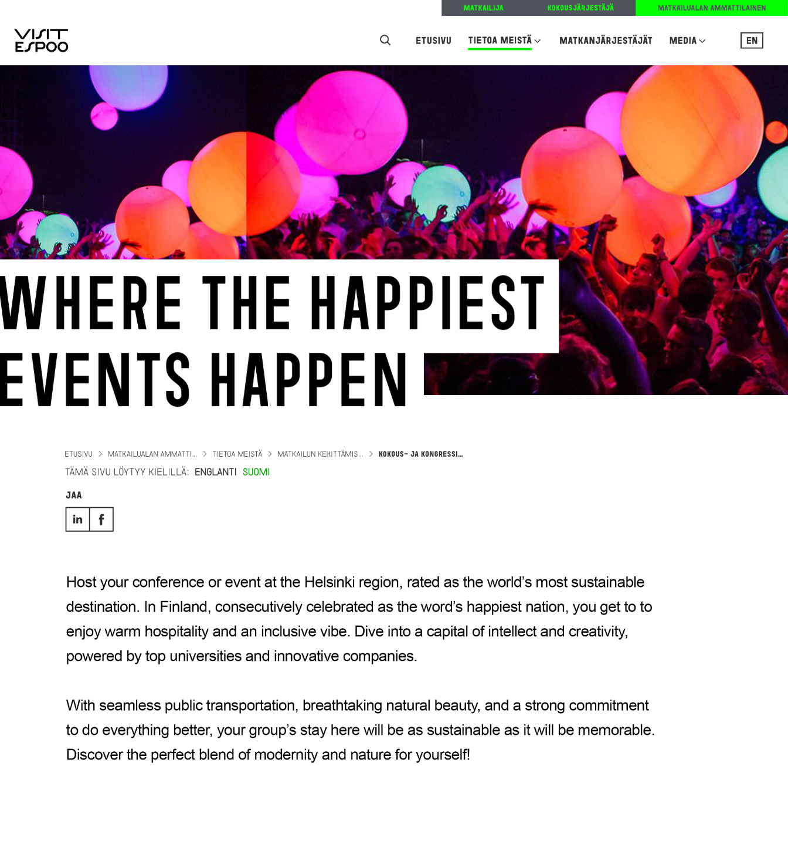
Esimerkkikuva, kuva ei lopulliseen käyttöön
Host your congress or event at the Helsinki region, rated as the world’s most sustainable destination. In Finland, consecutively celebrated as the word’s happiest nation, you get to to enjoy warm hospitality and an inclusive vibe. Dive into a capital of intellect and creativity, powered by top universities and innovative companies.
With seamless public transportation, breathtaking natural beauty, and a strong commitment to do everything better, your group’s stay here will be as sustainable as it will be memorable. Discover the perfect blend of modernity and nature for yourself!

Slide 10
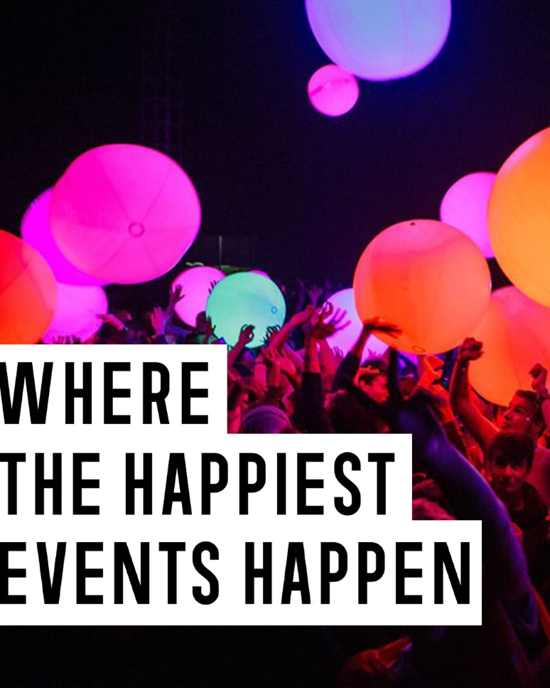
Esimerkkikuva, kuva ei lopulliseen käyttöön
Visit Espoo Bring your congress or event to the Helsinki region, a capital of happiness that’s been ranked as the world's most sustainable destination. Our changing seasons and dazzling Finnish nature provide memorable adventures between meetings, topped only by our friendly, hospitable locals.

Slide 11
Tarinan ja pääviestit toteutti: Miltton Oy
KOKEMO –Kongressit ja yritystapahtumat innovaatioiden ja kestävyyden moottoreina pääkaupunkiseudulla -hanke
Kuva: Antti Rastivo / Visit Espoo

